Slide 1
Introduction to Database

Slide 2
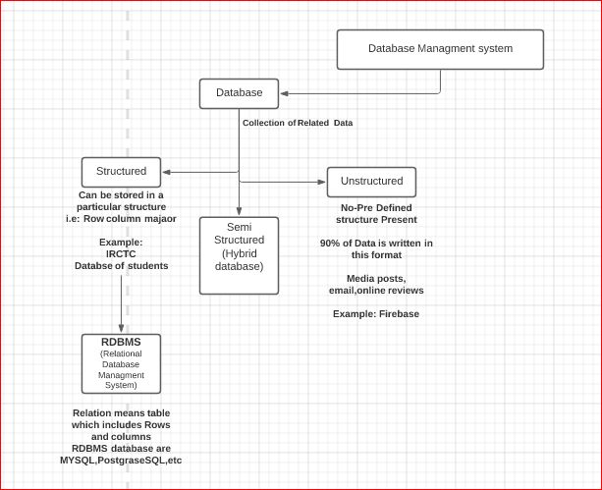

Slide 3
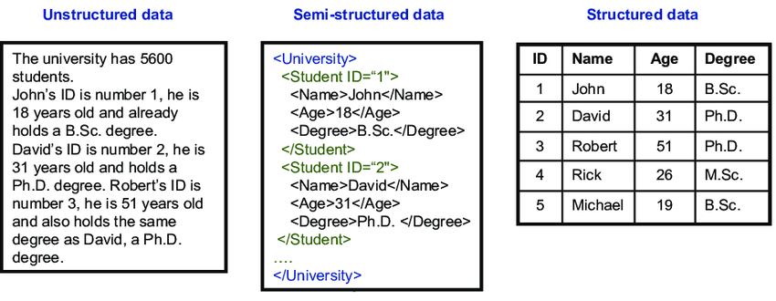

Slide 4
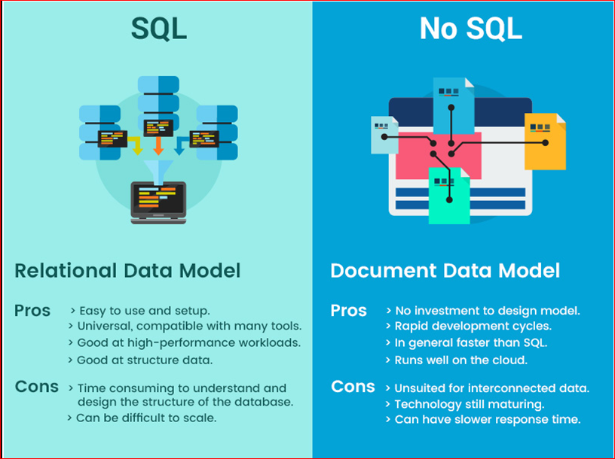
SQL vs NOSQL

Slide 5
Database architecture
2-level architecture
3-level architecture

Slide 6
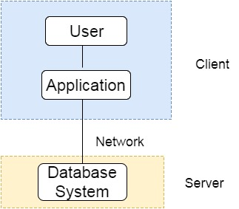
Two tier architecture:

Slide 7
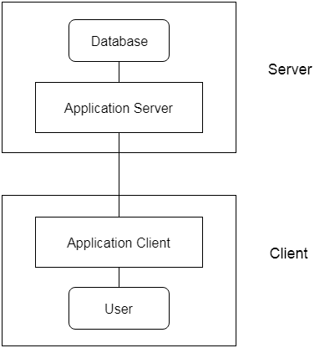
Three level architecture

Slide 8
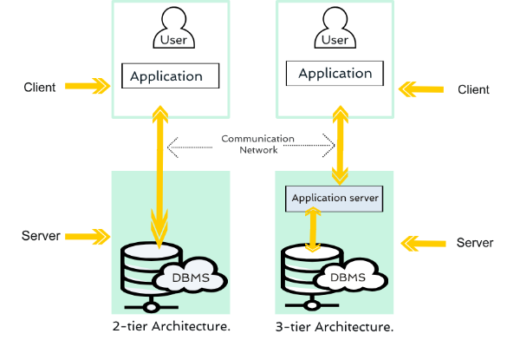
Difference

Slide 9
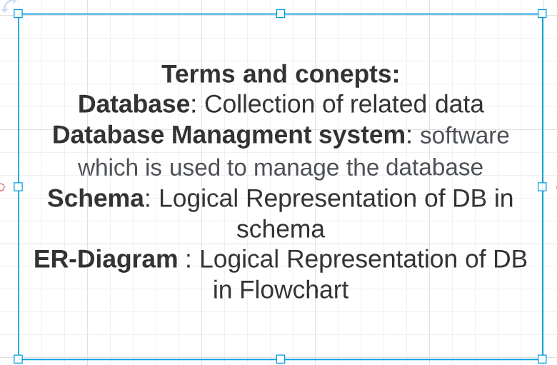

Slide 10
